Slide 1
More on K maps

Slide 2
Y(A,B,C,D) = AB+A’B’+A’BC +ABCD’ +AB’C

Slide 3
Y(A,B,C,D) = A’B’D’ + A’BD’+ AB’D’ + ABD’

Slide 4
Y(A,B,C,D) = A’B’ + A’B+ AB’ + AB

Slide 5
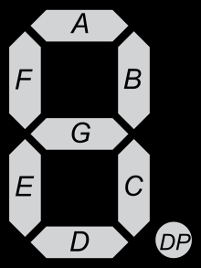
BCD to 7 segment display

Slide 7
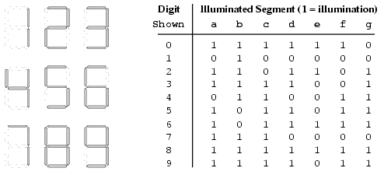

Slide 8
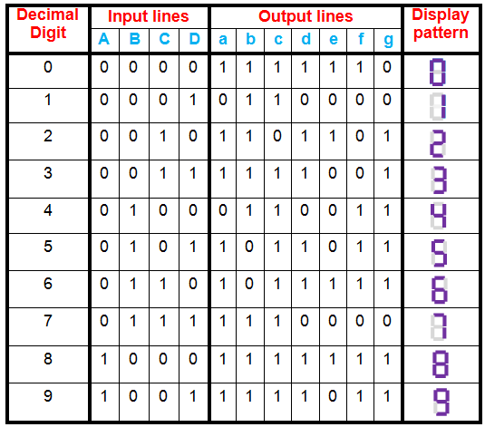
a = F1 (A, B, C, D) = ∑m (0, 2, 3, 5, 6, 7, 8, 9)
b = F2 (A, B, C, D) = ∑m (0, 1, 2, 3, 4, 7, 8, 9)
c = F3 (A, B, C, D) = ∑m (0, 1, 3, 4, 5, 6, 7, 8, 9)
d = F4 (A, B, C, D) = ∑m (0, 2, 3, 5, 6, 8)
e = F5 (A, B, C, D) = ∑m (0, 2, 6, 8)
f = F6 (A, B, C, D) = ∑m (0, 4, 5, 6, 8, 9)
g = F7 (A, B, C, D) = ∑m (2, 3, 4, 5, 6, 8, 9)

Slide 9
a = F1 (A, B, C, D) = ∑m (0, 2, 3, 5, 7, 8, 9)
b = F2 (A, B, C, D) = ∑m (0, 1, 2, 3, 4, 7, 8, 9)
c = F3 (A, B, C, D) = ∑m (0, 1, 3, 4, 5, 6, 7, 8, 9)
d = F4 (A, B, C, D) = ∑m (0, 2, 3, 5, 6, 8)
e = F5 (A, B, C, D) = ∑m (0, 2, 6, 8)
f = F6 (A, B, C, D) = ∑m (0, 4, 5, 6, 8, 9)
g = F7 (A, B, C, D) = ∑m (2, 3, 4, 5, 6, 8, 9)

Slide 10
